Slide 1
Michele MONTEVECCHI
LOC
Loreto
Open
Community
Development Manager Nhood Services Italy

Slide 3
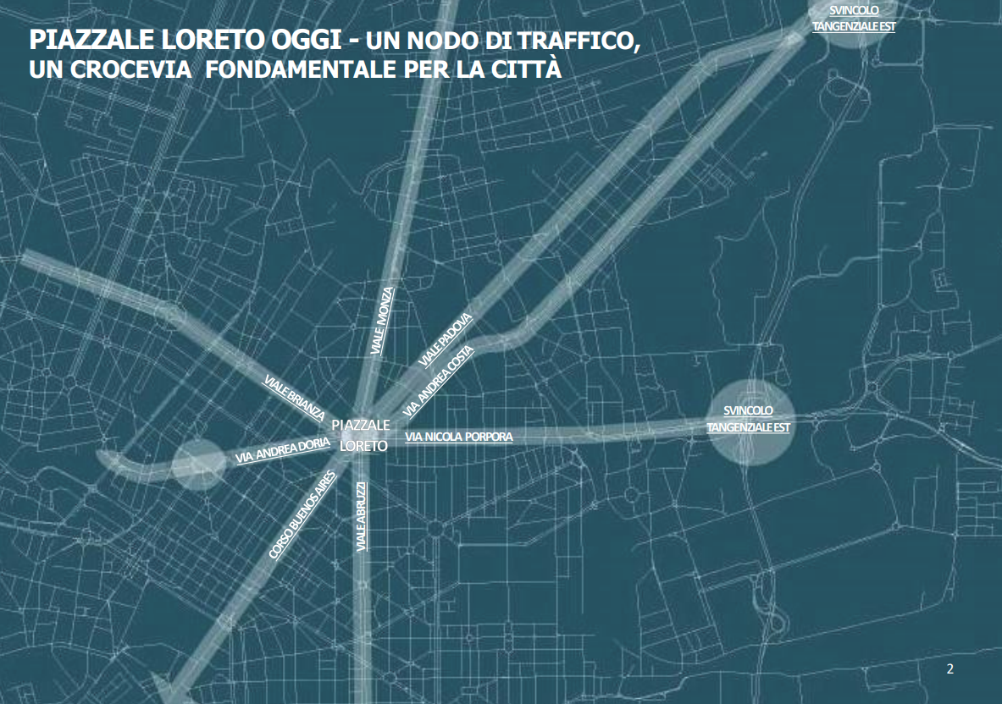

Slide 4
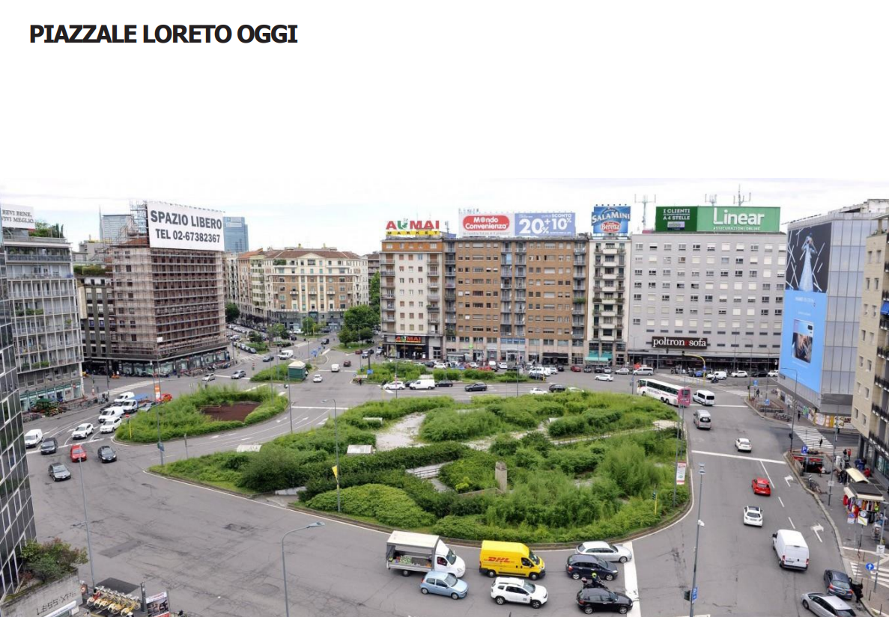

Slide 9
500 ALBERI DI CUI 300 PIANTUMATI A TERRA

Slide 14
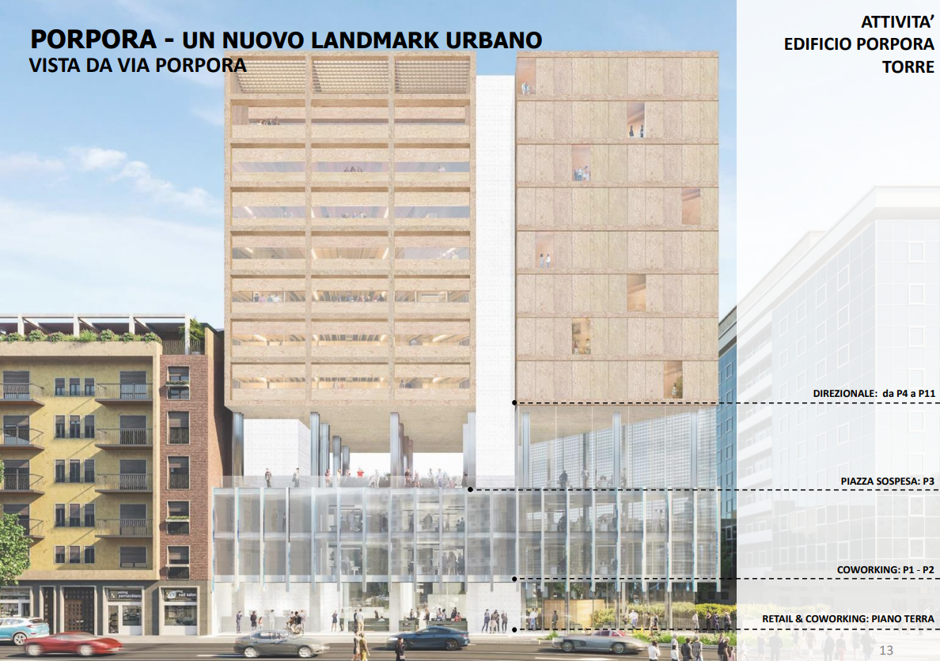

Slide 17
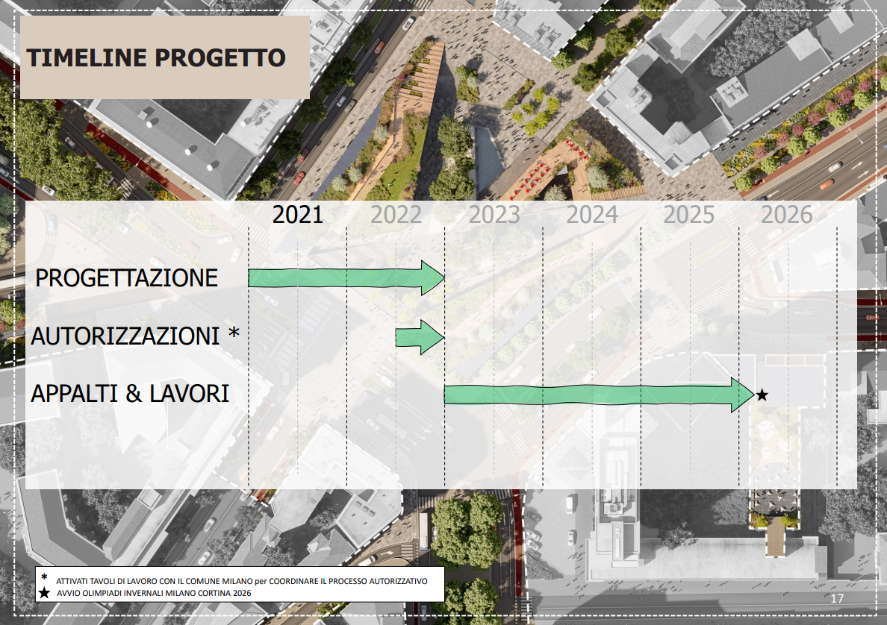

Slide 18
